Slide 1


Slide 4
Global Youtube Statistics Dashboard

Slide 6
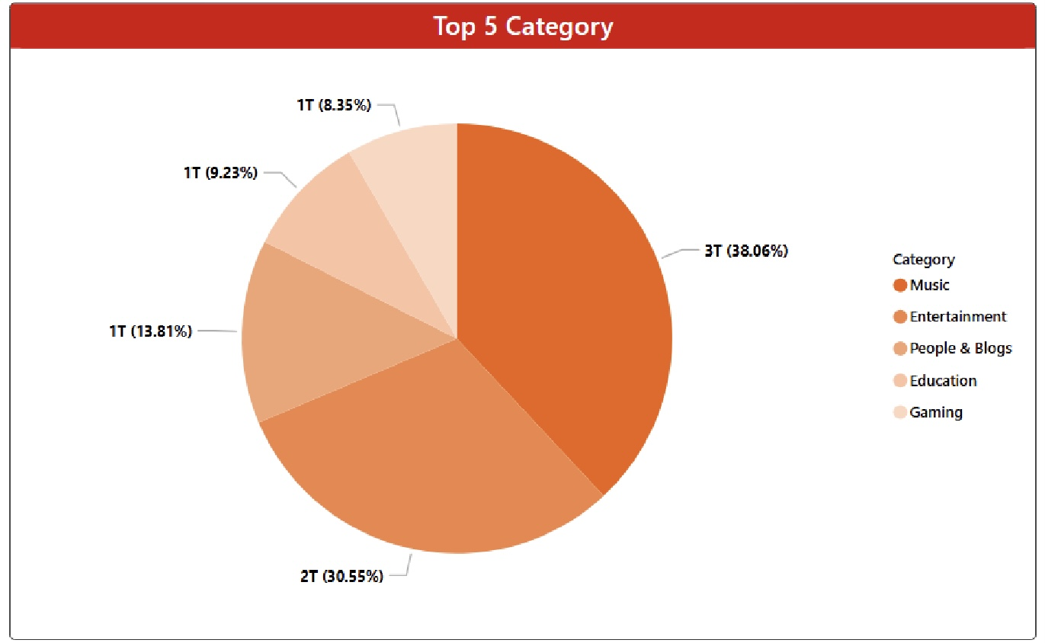
1
Top 5 Category

Slide 8
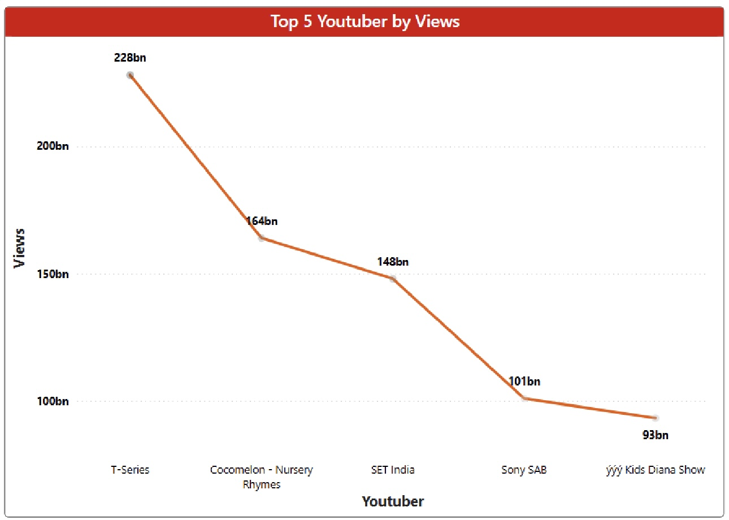
Top 5 Youtubers by Views
2

Slide 10
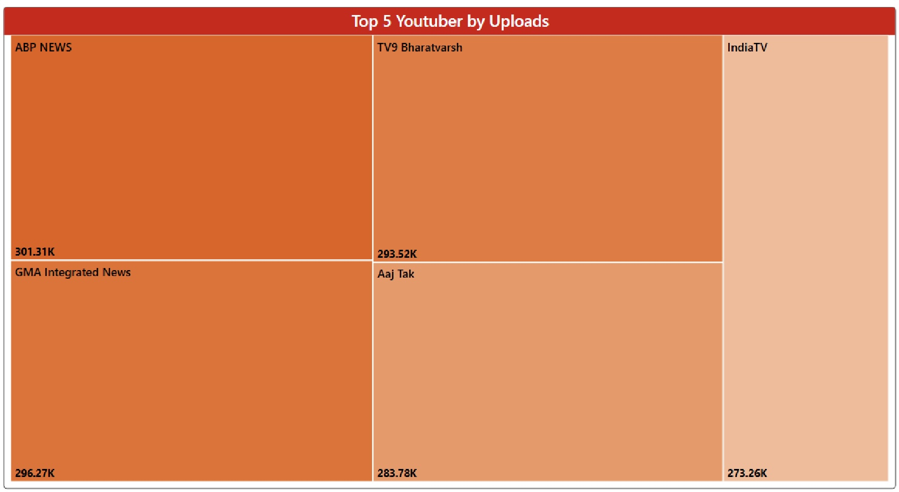
Top 5 Youtubers by Uploads
3

Slide 12
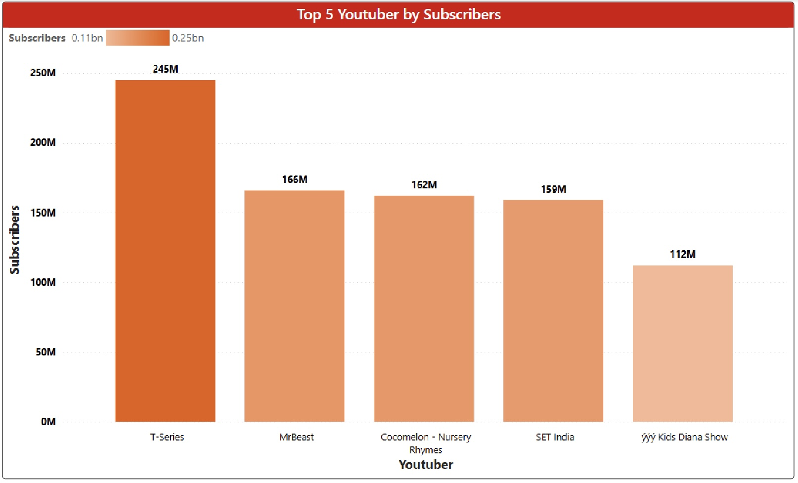
Top 5 Youtubers by Subscribers
4

Slide 14
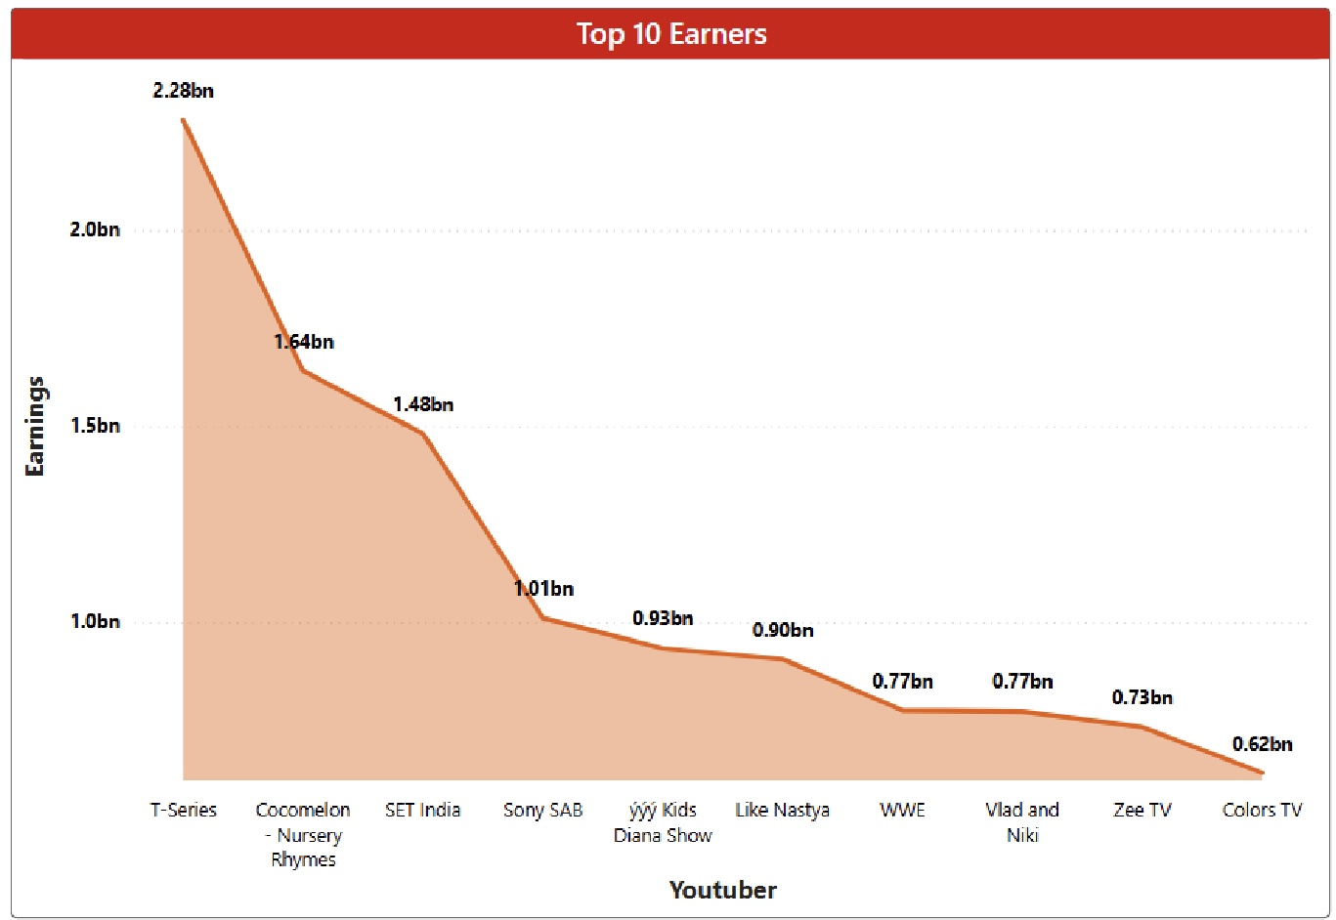
Top 10 Earners
5

Slide 16
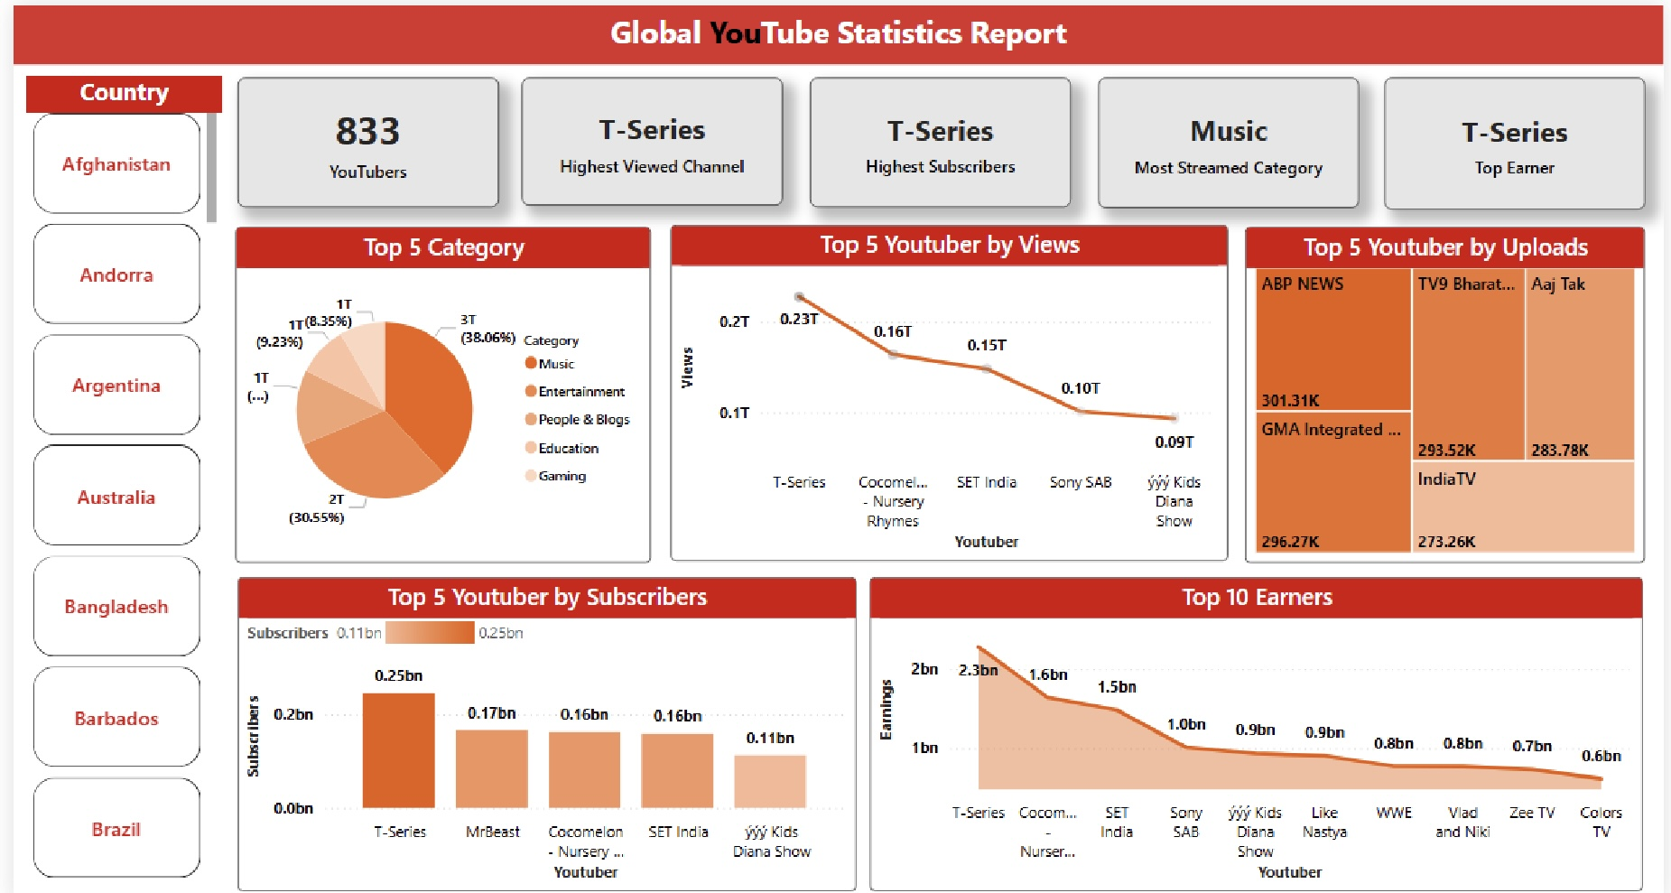
Full Detailed Dashboard

Slide 17
Thank You

Slide 18
Thank You

